Slide 1
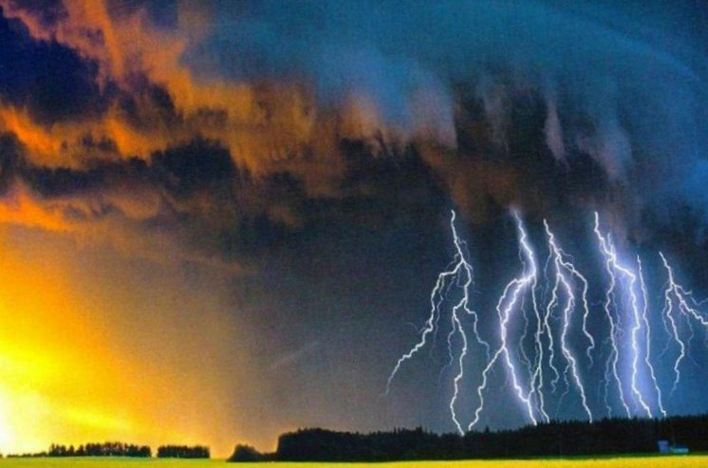
Design with Nature:
Biomorphic Art and Architecture
Science Café
April 14, 2015
Neil Greenberg
University of Tennessee – Knoxville
Notes:
April 14, 2015 Science Café : "Biomorphic Art and Architecture -- Design with Nature" Presented by STKF Science Café at Ijams Nature Center visitor center building meeting room, 5:30-7:00 PM. Science Café is a project of WGBH Science Unit in association with Sigma Xi. NOTES and RESOURCES for the SCIENCE CAFE. "Scientific, cultural, and spiritual connections between McHarg's landmark work in architecture will be linked with the work of other visionaries: The talk will be richly illustrated from (1) Ernst Haeckel's "Art Forms of Nature" (1899-1904) and its encouragement of an aesthetic, holistic vision of art and science based on his seminal research on oceanic microorganisms, and (2) the architecture of Antoni Gaudí, whose world-heritage architecture was deeply informed by and continually expresses his love and study of nature (spiritually manifest in his huge Sagrada Familia (basilica) in Barcelona (1883-contiunuing today).“
This gives a biological background to Kant’s famous aphorism:
"The senses cannot think. The understanding cannot see."
And Pascal’s
“The heart has reasons of which reason knows not”
( Kant in CPR cited by Wechsler 1978:2) (or: "Perception without conception is blind, while conception without perception is empty." (Kant CPR 1978) [recalls “Science without religion is lame, religion without science is blind.” (Albert Einstein in Science, Philosophy and Religion: a Symposium (1941) ch. 13)

Slide 2
Design with Nature
Endless pictures can be marshalled to underscore both the terrors and joys of nature. Threats and dangers are balanced by sublime beauty.
We are TERRIFIED and TROUBLED,
INFORMED and INSPIRED by NATURE.
Notes:
Natural science is one of man's weapons in his fight for freedom. For the purpose of attaining freedom in society, man must use social science to understand and change society and carry out social revolution. For the purpose of attaining freedom in the world of nature, man must use natural science to understand, conquer and change nature and thus attain freedom from nature.
Speech at the inaugural meeting of the Natural Science Research Society of the Border Region (February 5, 1940).

Slide 3
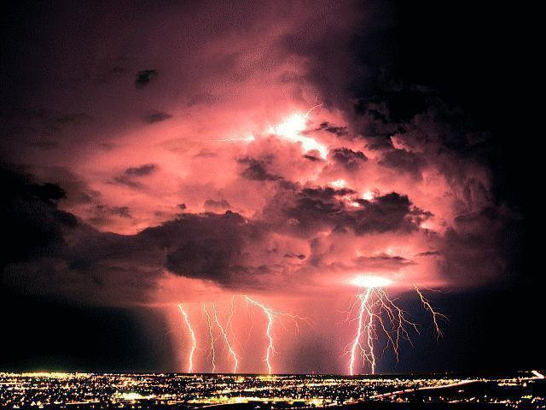
We are TERRIFIED and TROUBLED,
INFORMED and INSPIRED by NATURE.

Slide 4
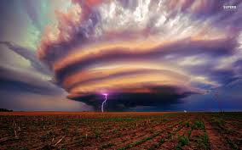
We are TERRIFIED and TROUBLED,
INFORMED and INSPIRED by NATURE.

Slide 5
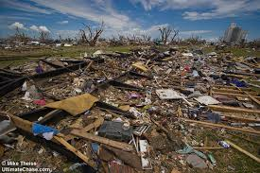
We are TERRIFIED and TROUBLED,
INFORMED and INSPIRED by NATURE.

Slide 6
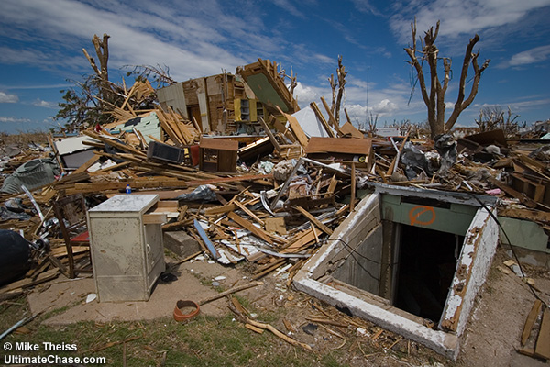
We are TERRIFIED and TROUBLED,
INFORMED and INSPIRED by NATURE.
Notes:
Greensburg Kansas 2007

Slide 7
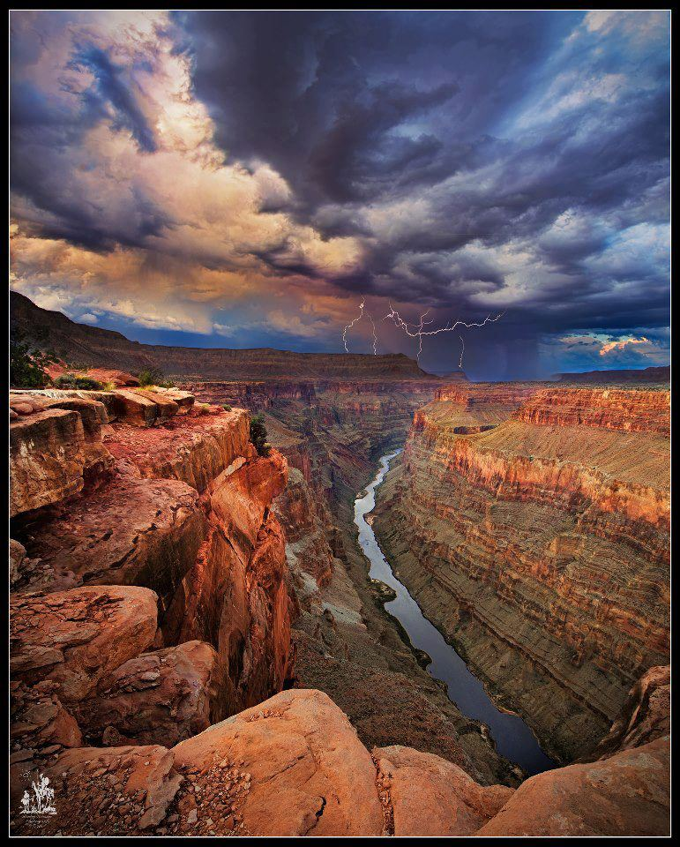
We are TERRIFIED and TROUBLED,
INFORMED and INSPIRED by NATURE.
Notes:
association with Sigma Xi. NOTES and RESOURCES for the SCIENCE CAFE. "Scientific, cultural, and spiritual connections between McHarg's landmark work in architecture will be linked with the work of other visionaries: The talk will be richly illustrated from (1) Ernst Haeckel's "Art Forms of Nature" (1899-1904) and its encouragement of an aesthetic, holistic vision of art and science based on his seminal research on oceanic microorganisms, and (2) the architecture of Antoni Gaudí, whose world-heritage architecture was deeply informed by and continually expresses his love and study of nature (spiritually manifest in his huge Sagrada Familia (basilica) in Barcelona (1883-contiunuing today).“
This gives a biological background to Kant’s famous aphorism:
"The senses cannot think. The understanding cannot see."
And Pascal’s
“The heart has reasons of which reason knows not”
( Kant in CPR cited by Wechsler 1978:2) (or: "Perception without conception is blind, while conception without perception is empty." (Kant CPR 1978) [recalls “Science without religion is lame, religion without science is blind.” (Albert Einstein in Science, Philosophy and Religion: a Symposium (1941) ch. 13)

Slide 8

We are TERRIFIED and TROUBLED,
INFORMED and INSPIRED by NATURE.
Notes:
association with Sigma Xi. NOTES and RESOURCES for the SCIENCE CAFE. "Scientific, cultural, and spiritual connections between McHarg's landmark work in architecture will be linked with the work of other visionaries: The talk will be richly illustrated from (1) Ernst Haeckel's "Art Forms of Nature" (1899-1904) and its encouragement of an aesthetic, holistic vision of art and science based on his seminal research on oceanic microorganisms, and (2) the architecture of Antoni Gaudí, whose world-heritage architecture was deeply informed by and continually expresses his love and study of nature (spiritually manifest in his huge Sagrada Familia (basilica) in Barcelona (1883-contiunuing today).“
This gives a biological background to Kant’s famous aphorism:
"The senses cannot think. The understanding cannot see."
And Pascal’s
“The heart has reasons of which reason knows not”
( Kant in CPR cited by Wechsler 1978:2) (or: "Perception without conception is blind, while conception without perception is empty." (Kant CPR 1978) [recalls “Science without religion is lame, religion without science is blind.” (Albert Einstein in Science, Philosophy and Religion: a Symposium (1941) ch. 13)

Slide 9
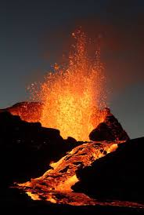
We are TERRIFIED and TROUBLED,
INFORMED and INSPIRED by NATURE.
Notes:
association with Sigma Xi. NOTES and RESOURCES for the SCIENCE CAFE. "Scientific, cultural, and spiritual connections between McHarg's landmark work in architecture will be linked with the work of other visionaries: The talk will be richly illustrated from (1) Ernst Haeckel's "Art Forms of Nature" (1899-1904) and its encouragement of an aesthetic, holistic vision of art and science based on his seminal research on oceanic microorganisms, and (2) the architecture of Antoni Gaudí, whose world-heritage architecture was deeply informed by and continually expresses his love and study of nature (spiritually manifest in his huge Sagrada Familia (basilica) in Barcelona (1883-contiunuing today).“
This gives a biological background to Kant’s famous aphorism:
"The senses cannot think. The understanding cannot see."
And Pascal’s
“The heart has reasons of which reason knows not”
( Kant in CPR cited by Wechsler 1978:2) (or: "Perception without conception is blind, while conception without perception is empty." (Kant CPR 1978) [recalls “Science without religion is lame, religion without science is blind.” (Albert Einstein in Science, Philosophy and Religion: a Symposium (1941) ch. 13)

Slide 10
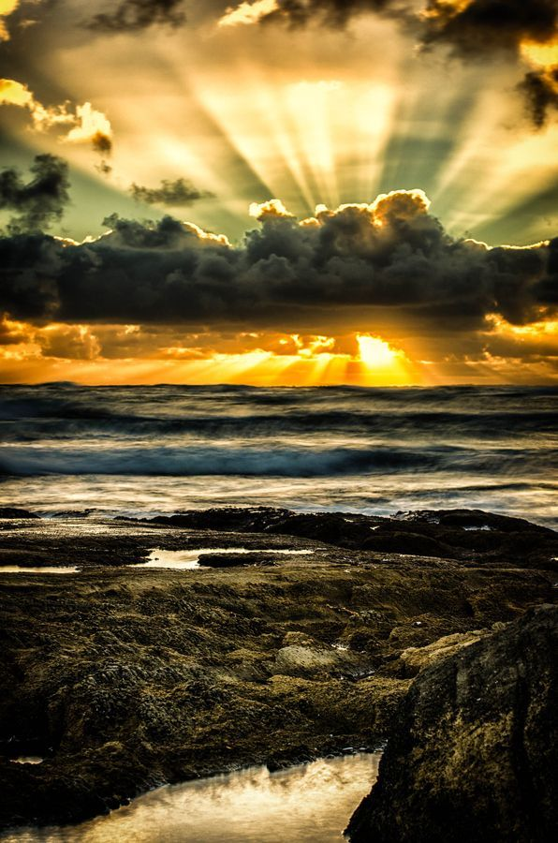
We are TERRIFIED and TROUBLED,
INFORMED and INSPIRED by NATURE.

Slide 11
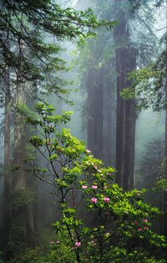
We are TERRIFIED and TROUBLED,
INFORMED and INSPIRED by NATURE.

Slide 12
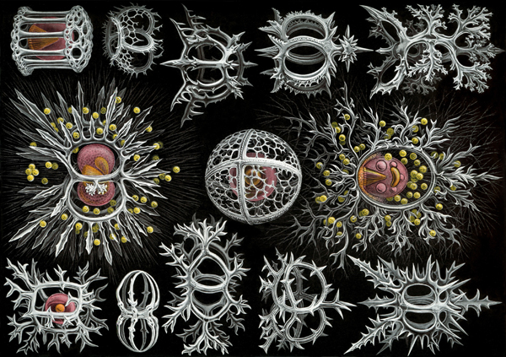
Foraminifera
Notes:
Members of phylum Foraminifera have calcerous external skeletons that are deposited at the bottom of thre sea and become incorporated into sedimentary rock. The White Cliffs of Dover are composed principally of the remains of foraminiferans.
Radiolarians are members of phylum Actinipoda, and represent another type of amoeboid organism that also has an external skeleton, but in this case composed of silica. Fossils of radiolarians have been removed from siliceous shale.
Both foraminiferans and radiolarians are represented by living forms as well as the fossils forms you see in the laboratory. Nearly all of these organisms are marine and found in pelagic (floating) or benthic (bottom dwelling) environments. --

Slide 13
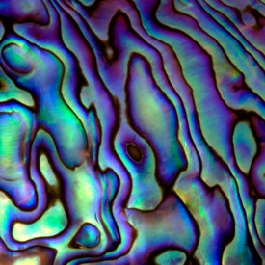
Nacre (calcium carbonite)
Notes:
Nacre is an iridescent layer of calcium carbonate lining the inside of shells of marine mollusks and is commonly known as "mother of pearl." It is composed of layers of uniformly oriented crystals of aragonite (a metastable form of calcium carbonate) separated by layers of organic matrix. How the ordered structure of aragonite layers is achieved has been unclear. Suzuki et al. (p. 1388, published online 8/13/09) identified two acidic matrix proteins (Pif 97 and Pif 80) that regulate nacre formation in the Japanese pearl oyster. The proteins appear to form a complex in which Pif 80 binds to aragonite and Pif 97 binds to other macromolecules in the organic matrix. (SCIENCE, Volume 325, Issue 5946, 9/11/2009) -- http://art-and-organism.blogspot.com/search?updated-max=2009-10-28T03:57:00-04:00&max-results=9 http://en.wikipedia.org/wiki/Nacre
A material similar to ceramic, although extremely tough, is found in nature.. Mother-of-pearl, which covers the shells of abalone and some bivalves, is 95% composed of calcium carbonate (aragonite), an intrinsically fragile material that is nonetheless very tough. Mother-of-pearl can be seen as a stack of small bricks, welded together with mortar composed of proteins. Its toughness is due to its complex, hierarchical structure where cracks must follow a tortuous path to propagate. It is this structure that inspired the researchers.
As a base ingredient, the team from the Laboratoire de Synthèse et Fonctionnalisation des Céramiques (CNRS/Saint-Gobain) used a common ceramic powder, alumina, in the form of microscopic platelets. To obtain the layered mother-of-pearl structure, they suspended this powder in water. The colloidal suspension (1) was then cooled to obtain controlled ice crystal growth, causing alumina to self-assemble in the form of stacks of platelets. The final material was subsequently obtained from a high temperature densification step.
This artificial mother-of-pearl is ten times tougher than a conventional alumina ceramic. This is because a crack has to move round the alumina "bricks" one by one to propagate. This zigzag pathway prevents it from crossing the material easily. -- http://www.sciencedaily.com/releases/2014/03/140324090250.htm

Slide 14
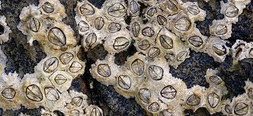
Barnacles
Notes:
Optical techniques reveal secrets of barnacle cement
23 Jul 2014 Discovery promises novel synthetic bioadhesives for medical implants, micro-electronics.Finally revealed: how barnacle cement is far stronger than any synthetic "superglue".More than 150 years since it was first described by Darwin, scientists are now uncovering the secrets behind the super strength of barnacle glue. Still far better than any synthetic adhesive, barnacle glue – or cement – sticks to any surface, under any conditions. But exactly how this ultimate superglue works has remained a mystery – until now.
An international team of scientists led by Newcastle University, UK, and funded by the US Office of Naval Research, have shown for the first time that barnacle larvae release an oily droplet to clear the water from surfaces before sticking down using a phosphoprotein adhesive. The work was published this week in Nature Communications.

Slide 15
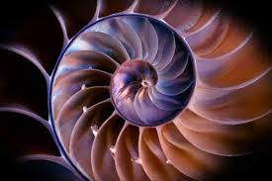
Chambered Nautilus
Notes:
http://en.wikipedia.org/wiki/Chambered_nautilus
Nautilus shells were popular items in the Renaissance cabinet of curiosities and were often mounted by goldsmiths on a thin stem to make extravagant nautilus shell cups, such as the Burghley Nef, mainly intended as decorations rather than for use. Small natural history collections were common in mid-19th-century Victorian homes, and chambered nautilus shells were popular decorations.
The chambered nautilus is the title and subject of a poem by Oliver Wendell Holmes, in which he admires the "ship of pearl" and the "silent toil/That spread his lustrous coil/Still, as the spiral grew/He left the past year's dwelling for the new." He finds in the mysterious life and death of the nautilus strong inspiration for his own life and spiritual growth. He concludes:
Build thee more stately mansions, O my soul,As the swift seasons roll!Leave thy low-vaulted past!Let each new temple, nobler than the last,Shut thee from heaven with a dome more vast,Till thou at length art free,Leaving thine outgrown shell by life's unresting sea!A painting by Andrew Wyeth, entitled "Chambered Nautilus", shows a woman in a canopied bed; the composition and proportions of the bed and the window behind it mirror those of a chambered nautilus lying on a nearby table.
The popular Russian rock band Nautilus Pompilius (Наутилус Помпилиус) is named after the species.
American composer and commentator Deems Taylor wrote a cantata entitled The Chambered Nautilus in 1916.
Cutaway of a nautilus shell showing the chambers
Empty nautilus shell, whole
Nautilus showing the tentacles
Internal anatomy of Nautilus pompilius

Slide 16
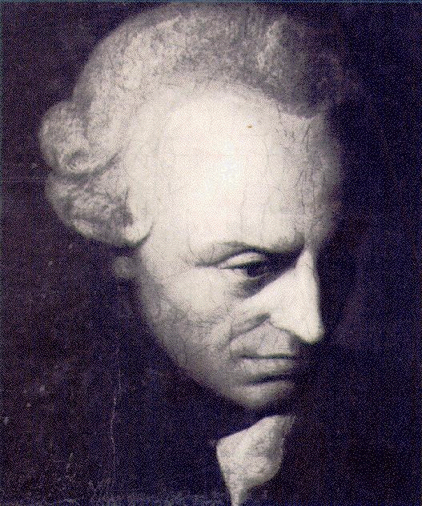
Immanuel Kant
Critique of Pure Reason,
1781
"The senses cannot think …
The understanding cannot see."
Notes:
This gives a biological background to Kant’s famous aphorism:
"The senses cannot think. The understanding cannot see."
BUT Kant believed that BOTH were necessary
And Pascal’s
“The heart has reasons of which reason knows not”
*Experience without theory is blind, but theory without experience is mere intellectual play.
This is declared to be "an old Kantian maxim" in General Systems Vol. 7-8 (1962)‎, p. 11, by the Society for the Advancement of General Systems Theory, but may simply be a paraphrase or summation of Kantian ideas.
Kant's treatment of the transcendental logic in the First Critique contains a portion, of which this quote may be an ambiguously worded paraphrase. Kant, claiming that both reason and the senses are essential to the formation of our understanding of the world, writes: "Without sensibility no object would be given to us, and without understanding none would be thought. Thoughts without content are empty, intuitions without concepts are blind (Critique of Pure Reason (1781; 1787) A51/B75)".
( Kant in CPR cited by Wechsler 1978:2) (or: "Perception without conception is blind, while conception without perception is empty." (Kant CPR 1978) [recalls “Science without religion is lame, religion without science is blind.” (Albert Einstein in Science, Philosophy and Religion: a Symposium (1941) ch. 13)

Slide 17
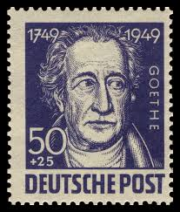
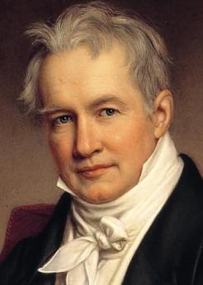
The 19th Century: A time of enormous political and intellectual change
Goethe (a literary celebrity / botanist); The Metamorphosis of Plants; took special pride in his scientific work; had the largest mineral specimen collection in Europe,
Humboldt (biogeographer / explorer / author) : “his treatise, Kosmos sought to unify diverse branches of scientific knowledge [and] motivated a holistic perception of the universe...”
Notes:
"Goethe and Humboldt believed, adapting ideas from Kant's third Critique, that aesthetic judgment complemented scientific understanding; each in its own mode captured the laws of nature, the principles according to which nature exhibited a unity underlying an ever astonishing variety. With Haeckel, aesthetic judgment would be fused with Darwinian understanding through a love now lifted beyond the individual." (Rbt Richards, 2004, in press)
Johann Wolfgang von Goethe (28 August 1749 – 22 March 1832) was a German writer and statesman. His body of work includes epic and lyric poetry written in a variety of metres and styles; prose and verse dramas; memoirs; an autobiography; literary and aesthetic criticism; treatises on botany, anatomy, and colour; and four novels. In addition, numerous literary and scientific fragments, more than 10,000 letters, and nearly 3,000 drawings by him are extant. A literary celebrity by the age of 25 ... After returning from a tour of Italy in 1788, his first major scientific work, the Metamorphosis of Plants, was published.
Friedrich Wilhelm Heinrich Alexander von Humboldt ( listen (help·info); September 14, 1769 – May 6, 1859) was a Prussian geographer, naturalist, and explorer, ... quantitative work on botanical geography laid the foundation for the field of biogeography. Humboldt's advocacy of long-term systematic geophysical measurement laid the foundation for modern geomagnetic and meteorological monitoring.^{[2][3]}
Between 1799 and 1804, Humboldt travelled extensively in Latin America, exploring and describing it for the first time from a modern scientific point of view. His description of the journey was written up and published in an enormous set of volumes over 21 years. Humboldt was one of the first to propose that the lands bordering the Atlantic Ocean were once joined (South America and Africa in particular). Humboldt resurrected the use of the word cosmos from the ancient Greek and assigned it to his multi-volume treatise, Kosmos, in which he sought to unify diverse branches of scientific knowledge. This important work also motivated a holistic perception of the universe as one interacting entity.^{[4]} Humboldt supported and worked with other scientists, including Joseph-Louis Gay-Lussac, Justus von Liebig, Louis Agassiz, Matthew Fontaine Maury, Georg von Neumayer, and most notably, Aimé Bonpland, with whom he conducted much of his scientific exploration.
Ernst Heinrich Philipp August Haeckel (German: [ˈhɛkəl]; 16 February 1834 – 9 August 1919^{[1]}) was a German biologist, naturalist, philosopher, physician, professor, and artist who discovered, described and named thousands of new species, mapped a genealogical tree relating all life forms, and coined many terms in biology, including anthropogeny, ecology, phylum, phylogeny, stem cell, and Protista. Haeckel promoted and popularized Charles Darwin's work in Germany and developed the controversial recapitulation theory ("ontogeny recapitulates phylogeny") claiming that an individual organism's biological development, or ontogeny, parallels and summarizes its species' evolutionary development, or phylogeny.
The published artwork of Haeckel includes over 100 detailed, multi-color illustrations of animals and sea creatures (see: Kunstformen der Natur, "Art Forms of Nature"). As a philosopher, Ernst Haeckel wrote Die Welträtsel (1895–1899, in English, The Riddle of the Universe, 1901), the genesis for the term "world riddle" (Welträtsel); and Freedom in Science and Teaching^{[2]} to support teaching evolution.” -- http://www.digplanet.com/wiki/Ernst_Haeckel

Slide 18
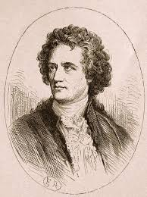
Both LOVE and BEAUTY is a likely dimension of a scientist’s vision:
Goethe believed that ...
"A man doesn't learn to understand anything unless he loves it"
Beauty? "Beauty is a harmonious relation between something in our nature and the quality of the object which delights us." (Pascal, d.1662).
“... a manifestation of secret natural laws, which otherwise would have been hidden from us forever." (Goethe, d 1832)
Notes:
Ernst Haeckel (seated) and his assistant Nikolai Miklucho on the way to the Canary
Islands in 1866. Haeckel had just visited Darwin in the village of Downe.
(Courtesy of Ernst-Haeckel-Haus, Jena.)
C4617.

Slide 19
SCIENCE and ART enables religion?
"He who possesses science and art also has religion..."
(Goethe, cited by Freud, 1830)
Notes:
[Goethe (as cited by Freud (1930) sees this from another perspective: "He who possesses science and art also has religion..."].

Slide 20
"Goethe and Humboldt believed, adapting ideas from Kant's third Critique, that aesthetic judgment complemented scientific understanding
... each in its own mode captured the laws of nature, the principles according to which nature exhibited a unity underlying an ever astonishing variety.
With Haeckel, aesthetic judgment would be fused with Darwinian understanding through a love now lifted beyond the individual." --Rbt Richards 2004
Notes:
"Goethe and Humboldt believed, adapting ideas from Kant's third Critique, that aesthetic judgment complemented scientific understanding; each in its own mode captured the laws of nature, the principles according to which nature exhibited a unity underlying an ever astonishing variety. With Haeckel, aesthetic judgment would be fused with Darwinian understanding through a love now lifted beyond the individual." (Rbt Richards, 2004, in press)
Ernst Heinrich Philipp August Haeckel (German: [ˈhɛkəl]; 16 February 1834 – 9 August 1919^{[1]}) was a German biologist, naturalist, philosopher, physician, professor, and artist who discovered, described and named thousands of new species, mapped a genealogical tree relating all life forms, and coined many terms in biology, including anthropogeny, ecology, phylum, phylogeny, stem cell, and Protista. Haeckel promoted and popularized Charles Darwin's work in Germany and developed the controversial recapitulation theory ("ontogeny recapitulates phylogeny") claiming that an individual organism's biological development, or ontogeny, parallels and summarizes its species' evolutionary development, or phylogeny.
The published artwork of Haeckel includes over 100 detailed, multi-color illustrations of animals and sea creatures (see: Kunstformen der Natur, "Art Forms of Nature"). As a philosopher, Ernst Haeckel wrote Die Welträtsel (1895–1899, in English, The Riddle of the Universe, 1901), the genesis for the term "world riddle" (Welträtsel); and Freedom in Science and Teaching^{[2]} to support teaching evolution.” -- http://www.digplanet.com/wiki/Ernst_Haeckel

Slide 21
A struggle between worldviews of humanity’s relationship with nature
CHANGE: innovative versus traditional world-views – the “maelstrom of disintegration and renewal”-- examples of expression in “culture wars” might be:
SCIENTIFIC observation and BIBLICAL literalism
REDUCTIONISM and HOLISM
REASON and PASSION; Science and Religion
CONSCIOUS and NONCONSCIOUS decision making (Freud)
HUMAN DOMINION or PARTICIPATION in NATURE
Notes:
Arguably, examples of culture wars are PROJECTIONS of the on-going tensions within human beings – such as primacy of INDIVIDUATION and SOCIALIZATION …
Selfishness versus selflessness

Slide 22
A struggle between worldviews of humanity’s relationship with nature
REALISM and EXPRESSIONISM; OBJECTIVE versus SUBJECTIVE REPRESENTATIONS of nature
TRANSMISSION of an IDEALISTIC or a REALISTIC NARRATIVE
EPHEMERAL versus ETERNAL
Notes:
Arguably, examples of culture wars are PROJECTIONS of the on-going tensions within human beings – such as primacy of INDIVIDUATION and SOCIALIZATION …
Selfishness versus selflessness

Slide 23
Design with Nature
This is both PRACTICAL and SPIRITUAL
We must meet BIOLOGICAL NEEDS: seek to control what we fear for our own safety
we can emulate what we observe in order to appropriate its power
Our experience of nature –horizon after horizon of mystery-- is also a great wellspring of spirituality
Notes:
SPRITUAL?
If we believe, like Whitman, that All truths wait in all things, and like Roethke that
“All finite things reveal infinitude” and like Elizabteh Barrett Browing that “Earth's crammed with heaven, And every common bush afire with God.”
All truths wait in all things,
They neither hasten their own delivery nor resist it,
They do not need the obstetric forceps of the surgeon.
The insignificant is as big to me as any,
What is less or more than a touch?
Logic and sermons never convince,
The damp of the night drives deeper into my soul.
Only what proves itself to every man and woman is so,
Only what nobody denies is so.
--Walt Whitman, "Song of Myself," lines 647-655.
Recalls
“All finite things reveal infinitude” (Theodore Roethke: in The Far Field IV 1964).
and
“Earth's crammed with heaven, And every common bush afire with God.” (Elizabeth Barrett Browning, Aurora Leigh)

Slide 24
Design with Nature
IDENTITY CRISIS: we can are reminded of the fragility of our species … but then we can exalt in our triumph over the adversities nature can present
– we defend ourselves from predators …we survive winter the exigencies of climate, we have tamed fire (now we’re seeking to tame nuclear fusion),
We experience a stressful tension when we “shift gears” from a sense of our fragility and vulnerability in the face of a sense of mastery and control (bordering on omnipotence)
BIOLOGICAL NEEDS are implied by “nature deprivation disorder”
Notes:
The tension between
our fragility in the face of seemingly endless time and space -- So we are as ripples on the surface of reality …
Our omnipotence aware of all that is or ever could be takes place within us … it exists in our mind … it puts us at the center of the universe.
Natural science is one of man's weapons in his fight for freedom. For the purpose of attaining freedom in society, man must use social science to understand and change society and carry out social revolution. For the purpose of attaining freedom in the world of nature, man must use natural science to understand, conquer and change nature and thus attain freedom from nature.
Speech at the inaugural meeting of the Natural Science Research Society of the Border Region (February 5, 1940).

Slide 25
Design with Nature
To facilitate cognitive process of deciding, we often exaggerate the differences between alternatives: Are we “at war” with nature? Sometimes it seems so.
FREEDOM? – means free of “constraints” on one’s will ... But calculating the cost of freedom involves anticipating the consequences: it is why we have a prefrontal cortex.
Notes:
Natural science is one of man's weapons in his fight for freedom. For the purpose of attaining freedom in society, man must use social science to understand and change society and carry out social revolution. For the purpose of attaining freedom in the world of nature, man must use natural science to understand, conquer and change nature and thus attain freedom from nature.
Speech at the inaugural meeting of the Natural Science Research Society of the Border Region (February 5, 1940).

Slide 26
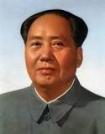
There is a “middle path” between extremes
Ironically this was neglected when thousands of years of Taoist and Confucian culture were set aside:
“For the purpose of attaining freedom in the world of nature, man must use natural science to understand, conquer and change nature and thus attain freedom from nature.”
--Mao, 1940
Notes:
Natural science is one of man's weapons in his fight for freedom. For the purpose of attaining freedom in society, man must use social science to understand and change society and carry out social revolution. For the purpose of attaining freedom in the world of nature, man must use natural science to understand, conquer and change nature and thus attain freedom from nature.
Speech at the inaugural meeting of the Natural Science Research Society of the Border Region (February 5, 1940).
Katherine Hepburn (missionary escaping on “he African Queen” with the help of Humphrey Bogart (boat captain): “Nature, Mr. Allnut, is what we are put on this world to rise above.”

Slide 27
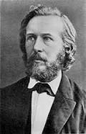
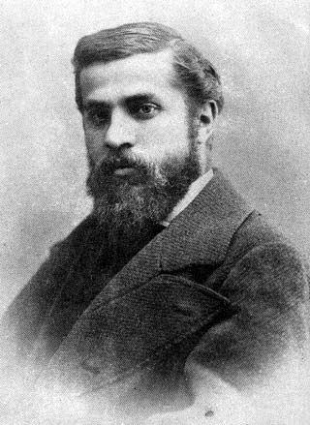
Epitomes of integration: Two proponants of the emerging worldview
Ernst HAECKEL – the scientist -- an eminent zoologist who sought to express himself through art –He exemplified the intertwining of art and science for popular culture
Antoni GAUDI – the artist – Barcelona’s greatest architect whose sense of nature inspired all his work and its ultimate expression in one of the world’s great cathedrals
Notes:
April 14, 2015 Science Café : "Biomorphic Art and Architecture -- Design with Nature" Presented by STKF Science Café at Ijams Nature Center visitor center building meeting room, 5:30-7:00 PM. Science Café is a project of WGBH Science Unit in association with Sigma Xi. NOTES and RESOURCES for the SCIENCE CAFE. "Scientific, cultural, and spiritual connections between McHarg's landmark work in architecture will be linked with the work of other visionaries: The talk will be richly illustrated from (1) Ernst Haeckel's "Art Forms of Nature" (1899-1904) and its encouragement of an aesthetic, holistic vision of art and science based on his seminal research on oceanic microorganisms, and (2) the architecture of Antoni Gaudí, whose world-heritage architecture was deeply informed by and continually expresses his love and study of nature (spiritually manifest in his huge Sagrada Familia (basilica) in Barcelona (1883-contiunuing today).“
This gives a biological background to Kant’s famous aphorism:
"The senses cannot think. The understanding cannot see."
And Pascal’s
“The heart has reasons of which reason knows not”
( Kant in CPR cited by Wechsler 1978:2) (or: "Perception without conception is blind, while conception without perception is empty." (Kant CPR 1978) [recalls “Science without religion is lame, religion without science is blind.” (Albert Einstein in Science, Philosophy and Religion: a Symposium (1941) ch. 13)

Slide 28

Ernst Haeckel (seated) and his assistant Nikolai Miklucho on the way to the Canary Islands in 1866.
Haeckel had just visited Darwin in the village of Downe.
Notes:
Ernst Haeckel (seated) and his assistant Nikolai Miklucho on the way to the Canary
Islands in 1866. Haeckel had just visited Darwin in the village of Downe.
(Courtesy of Ernst-Haeckel-Haus, Jena.)
C4617.

Slide 29
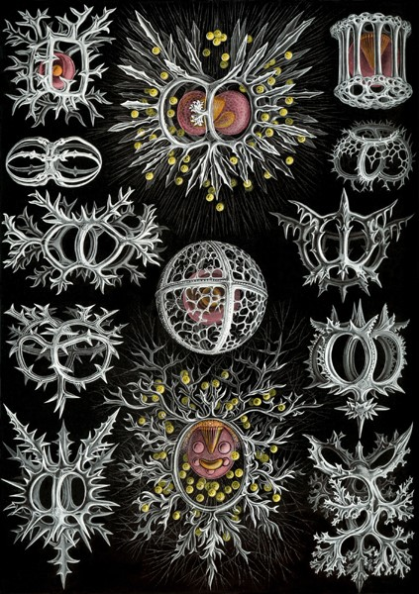
“The most magnificent works which I have ever seen,,,”
--Darwin to Haeckel
Haeckel, encouraged by Darwin’s enthusiasm for the etchings of radiolarians in his 1864 book became his most influential advocate …
Notes:
In late winter of 1864, Charles Darwin received two folio volumes on radiolarians, a group of one-celled marine organisms that secreted siliceous skeletons of unusual geometry. The author, the young German biologist Ernst Haeckel (fig. 1), had himself drawn the figures for the extraordinary copper-etched illustrations that filled the second volume. The gothic beauty of the plates astonished Darwin (fig. 2 ), but he must also have been drawn to passages that applied his theory to construct the descent relations of these little known creatures. He replied to Haeckel that the volumes "were the most magnificent works which I have ever seen, & I am proud to possess a copy from the author." Ernst Haeckel, Die Radioloarien. (Rhizopoda Radiaria.) Eine Monographie , 2 vols. (Berlin: Georg Reimer, 1862).
Charles Darwin to Ernst Haeckel (3 March 1864), in Correspondence of Ernst Haeckel, in the Haeckel Papers, Institut für Geschichte der Medizin und der Naturwissenschaften, Ernst-Haeckel-Haus, Friedrich-Schiller-Universität, Jena. Hereafter I will refer to this as "Haeckel Correspondence, Haeckel-Haus, Jena."

Slide 30
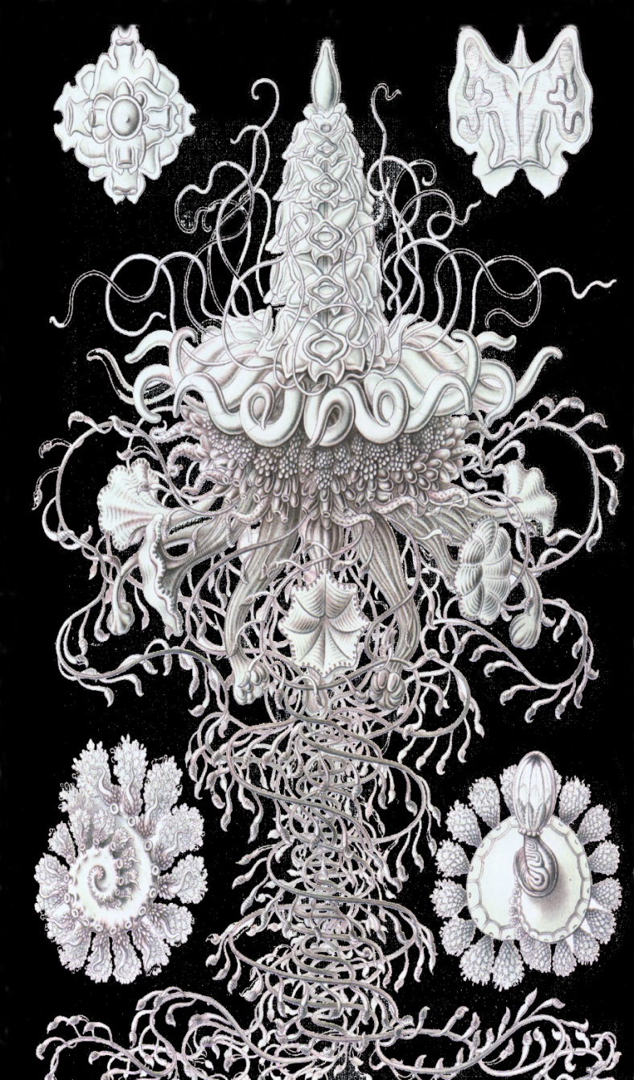
Haeckel’s influence
ARTFORMS in NATURE (Kunstformen der Natur 1899-1904) contained the “best” 100 of his over 1000 drawings)
…deeply influenced
early 20th-century art, architecture, and design
Art Nouveau in particular was influenced by Haeckel's images,
Notes:
Kunstformen der Natur (known in English as Art Forms in Nature) is a book of lithographic and halftone prints by German biologist Ernst Haeckel.
Contents
[hide]
1 Publication
2 Themes
3 Influence
4 Gallery of prints
5 References
6 External links
Publication[edit]
Originally published in sets of ten between 1899 and 1904 and collectively in two volumes in 1904,^{[2]} it consists of 100 prints of various organisms, many of which were first described by Haeckel himself. Over the course of his career, over 1000 engravings were produced based on Haeckel's sketches and watercolors; many of the best of these were chosen for Kunstformen der Natur, translated from sketch to print by lithographer Adolf Giltsch.^{[3]}
Kunstformen der Natur was influential in early 20th-century art, architecture, and design, bridging the gap between science and art. In particular, many artists associated with Art Nouveau were influenced by Haeckel's images, including René Binet, Karl Blossfeldt, Hans Christiansen, and Émile Gallé. One prominent example is the Amsterdam Commodities Exchange designed by Hendrik Petrus Berlage: it was in part inspired by Kunstformen illustrations.^{[5]}

Slide 31
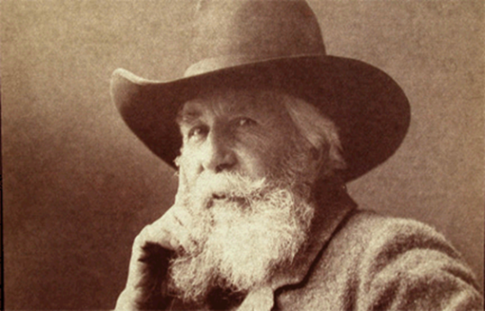
ARTFORMS in NATURE (Kunstformen der Natur 1899-1904)
The Gothic beauty of contained the “best” 100 of his over 1000 drawings) deeply influenced …
early 20th-century art, architecture, and design
Art Nouveau in particular was influenced by Haeckel's images,
He successfully infused the beautiful fluidity of nature with fluidity with the “authority” of science
Notes:
In late winter of 1864, Charles Darwin received two folio volumes on radiolarians, a group of one-celled marine organisms that secreted siliceous skeletons of unusual geometry. The author, the young German biologist Ernst Haeckel (fig. 1), had himself drawn the figures for the extraordinary copper-etched illustrations that filled the second volume. The gothic beauty of the plates astonished Darwin (fig. 2 ), but he must also have been drawn to passages that applied his theory to construct the descent relations of these little known creatures. He replied to Haeckel that the volumes "were the most magnificent works which I have ever seen, & I am proud to possess a copy from the author." Ernst Haeckel, Die Radioloarien. (Rhizopoda Radiaria.) Eine Monographie , 2 vols. (Berlin: Georg Reimer, 1862).
Charles Darwin to Ernst Haeckel (3 March 1864), in Correspondence of Ernst Haeckel, in the Haeckel Papers, Institut für Geschichte der Medizin und der Naturwissenschaften, Ernst-Haeckel-Haus, Friedrich-Schiller-Universität, Jena. Hereafter I will refer to this as "Haeckel Correspondence, Haeckel-Haus, Jena."

Slide 32
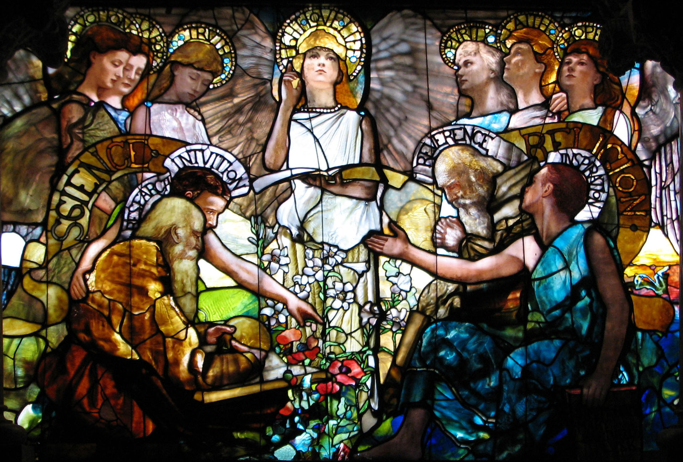
ARTFORMS in NATURE (Kunstformen der Natur 1899-1904)
ART NOUVEAUX: Tiffany’s “Education”
Notes:
In late winter of 1864, Charles Darwin received two folio volumes on radiolarians, a group of one-celled marine organisms that secreted siliceous skeletons of unusual geometry. The author, the young German biologist Ernst Haeckel (fig. 1), had himself drawn the figures for the extraordinary copper-etched illustrations that filled the second volume. The gothic beauty of the plates astonished Darwin (fig. 2 ), but he must also have been drawn to passages that applied his theory to construct the descent relations of these little known creatures. He replied to Haeckel that the volumes "were the most magnificent works which I have ever seen, & I am proud to possess a copy from the author." Ernst Haeckel, Die Radioloarien. (Rhizopoda Radiaria.) Eine Monographie , 2 vols. (Berlin: Georg Reimer, 1862).
Charles Darwin to Ernst Haeckel (3 March 1864), in Correspondence of Ernst Haeckel, in the Haeckel Papers, Institut für Geschichte der Medizin und der Naturwissenschaften, Ernst-Haeckel-Haus, Friedrich-Schiller-Universität, Jena. Hereafter I will refer to this as "Haeckel Correspondence, Haeckel-Haus, Jena."

Slide 33
Antoni Gaudi
"Those who look for the laws of Nature as a support for their new works collaborate with the creator."
Antoni Gaudi, 1878
Notes:
"Those who look for the laws of Nature as a support for their new works collaborate with the creator."

Slide 34
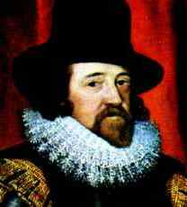
Design with Nature
knowledge itself is power.
—Sir Francis Bacon 1597
You will not master nature unless you obey it.
—Sir Francis Bacon 1620
Notes:
. Naturam non vinces nisi parendo (You will not master [conquer] nature unless you obey it) Francis Bacon, Novum Organum, 1620
Nam et ipsa scientia potestas est. [For knowledge itself is power. Francis Bacon, Meditations Sacrae (1597)

Slide 35
IDEOLOGICAL causes and consequences of BIOMORPHIC ART
Biomorphic Art and Architecture -- Design with Nature
In Italy, design with a strongly organic feel played a major role in post-war reconstruction. With the straight geometrical lines of rationalism tainted by association with Fascism, designers turned to the curve.
Notes:
In Italy, design with a strongly organic feel played a major role in post-war reconstruction. With the straight geometrical lines of rationalism tainted by association with Fascism, designers turned to the curve. Fusing aspects of American design, Surrealism and the sculptures of Moore and Arp, a distinctive organic aesthetic appeared throughout Italy, from industrial design - cars, typewriters, and Vespas - to interior design and furniture. The bentwood and metal furniture of Carlo Mollino (1905-73), for example, shows a debt to those sources as well as to an earlier pioneer of organic design, Antoni Gaudi (1852-1926), to whom he paid homage with his Gaudi chair of 1949. Achille Castiglioni (1918-2002) also made furniture that specifically referred to avant-garde art - Dada and Surrealism, and the practice of the use of the 'found object'. His 1957 Sella (saddle) stool - made from a bicycle seat - and Mezzadro chair - made from a tractor seat - neatly restate the recurring debate about the relationship between art and design, and design and technology. -- http://www.visual-arts-cork.com/history-of-art/biomorphic-abstraction.htm

Slide 36
ERNST HAECKEL’s continuing identity crisis reflected in ...
the tensions between ART and SCIENCE that played out in his life and career epitomized the great cultural tensions between the heart and mind, emotion and reason, experienced by 19th century Europe
This tension is still ongoing
EH Haeckel 1834-1919
Notes:
This gives a biological background to Kant’s famous aphorism:
"The senses cannot think. The understanding cannot see."
And Pascal’s
“The heart has reasons of which reason knows not”
( Kant in CPR cited by Wechsler 1978:2) (or: "Perception without conception is blind, while conception without perception is empty." (Kant CPR 1978) [recalls “Science without religion is lame, religion without science is blind.” (Albert Einstein in Science, Philosophy and Religion: a Symposium (1941) ch. 13)

Slide 37
Darwin gave Haeckel great encouragement when, in 1864, he received two folio volumes on radiolarians –
. The gothic beauty of the plates astonished Darwin (fig. 2 ), but he must also have been drawn to passages that applied his theory to construct the descent relations of these little known creatures. He replied to Haeckel that the volumes "were the most magnificent works which I have ever seen,
Notes:
The Foundation of Ernst Haeckel’s Evolutionary Project in Morphology, Aesthetics, and Tragedy
Robert J. Richards
The University of Chicago
In late winter of 1864, Charles Darwin received two folio volumes on radiolarians, a group of one-celled marine organisms that secreted siliceous skeletons of unusual geometry. The author, the young German biologist Ernst Haeckel (fig. 1), had himself drawn the figures for the extraordinary copper-etched illustrations that filled the second volume. The gothic beauty of the plates astonished Darwin (fig. 2 ), but he must also have been drawn to passages that applied his theory to construct the descent relations of these little known creatures. He replied to Haeckel that the volumes "were the most magnificent works which I have ever seen,

Slide 38
spiritual dimension
"Those who look for the laws of Nature as a support for their new works collaborate with the creator."
Antoni Gaudi, 1878
Notes:
"Those who look for the laws of Nature as a support for their new works collaborate with the creator."

Slide 39
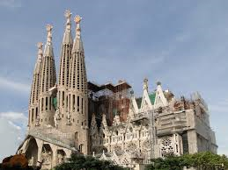
Sagrada Familia
Notes:
The expiatory church of La Sagrada Família, declared world heritage by UNESCO
On 17 July 2005, at a meeting held in Durban in South Africa, UNESCO decided to add the expiatory church of La Sagrada Família to the works which have been declared world heritage. Specifically, the Nativity facade, the apse and the crypt; in other words, the parts Gaudí did directly and were finished by his immediate successors. Casa Vicens and Casa Batlló won the same recognition.
It is worth pointing out that the crypt was begun by the architect of the diocese, Francesc de Paula del Villar, who built the foundations and raised the perimeter walls and the pillars a few metres. Gaudí, who was his successor, made major changes which modified the original project. Specifically, he replaced the staircase joining the floor of the church with the crypt by the two new circular flights of steps on either side of the apse chapels. He also introduced a moat to provide the interior with ventilation and light and give the central vault greater height. The capitals, the cartouches with figures of angels and the Annunciation keystone, as well as the stained glass, are mostly his work, as are the liturgical elements and the furniture.
Despite the fire and the damage caused in 1936, the faithful restoration by the architect Quintana and the manufacture of the furniture by the craftsmen who had worked with Gaudí have ensured that the altars, confession boxes, benches, etc., are fully part of the master’s work.
ENJOY NATURE http://www.sagradafamilia.cat/sf-eng/docs_serveis/exposPermanents.php
From a painstaking task of investigation of Gaudí’s geometry and a later comparison of it with nature, this exhibition emerges. It sets out to discover the roots of the organic architecture he used in his works, mainly in the last and greatest, the church of La Sagrada Família. To achieve that aim images are used to compare the animal, vegetable and mineral kingdoms, accompanied by objects, models and living plants which Gaudí studied and transferred to his architecture.
Location: Montserrat cloister / Nativity facade

Slide 40
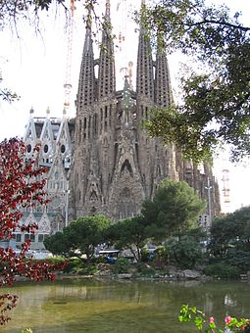
1882 work began
1883 Gaudi took over
1936—fire and vandalism
2005 –World Heritage Site
2026—scheduled completion
Notes:
What few models and sketches there were by Gaudí’s hand were mostly destroyed by Catalan anarchists when they assaulted the Sagrada Família during the Spanish Civil War. They did, however, leave the architect’s tomb intact. For, whatever their grudge against General Franco and the Catholic Church, they knew full well that Gaudí was considered a saint by people of all classes and political beliefs.

Slide 41
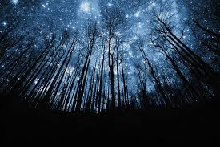
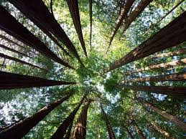
Sagrada Familia
Notes:
< 1 >
ENJOY NATURE http://www.sagradafamilia.cat/sf-eng/docs_serveis/exposPermanents.php
From a painstaking task of investigation of Gaudí’s geometry and a later comparison of it with nature, this exhibition emerges. It sets out to discover the roots of the organic architecture he used in his works, mainly in the last and greatest, the church of La Sagrada Família. To achieve that aim images are used to compare the animal, vegetable and mineral kingdoms, accompanied by objects, models and living plants which Gaudí studied and transferred to his architecture.
Location: Montserrat cloister / Nativity facade

Slide 42
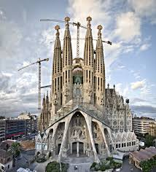
combining geometrical forms, chosen for their formal, structural, luminous, acoustic and constructive qualities: hyperboloids, paraboloids, helicoids, conoids and ellipsoids
Notes:
GEOMETRY
During the last fifteen years of his life, Gaudí planned many parts of the church so that they could be built in the future. He did so combining geometrical forms, chosen for their formal, structural, luminous, acoustic and constructive qualities: hyperboloids, paraboloids, helicoids, conoids and ellipsoids. Many of these surfaces are ruled, which makes the construction easier. He assigned one of these forms to each type of the elements that make up the naves. With helicoids he invented a new column in the history of architecture: the double twisted column. He used hyperboloids for the openings of the windows and the vaults. With paraboloids he created linking surfaces on the vaults, the roofs and the columns of the Passion façade. He generated the knots or capitals of the main columns with ellipsoids. And earlier he had planned the building of the parish schools with conoids.
Moreover, Gaudí developed a system of proportions applied to all the dimensions and elements of the church.
DOUBLE TWISTED COLUMN
RULED SURFACES
HYPERBOLOID
HYPERBOLIC PARABOLOID
HELICOID AND CONOID
ELLIPSOID
PROPORTIONS

Slide 43
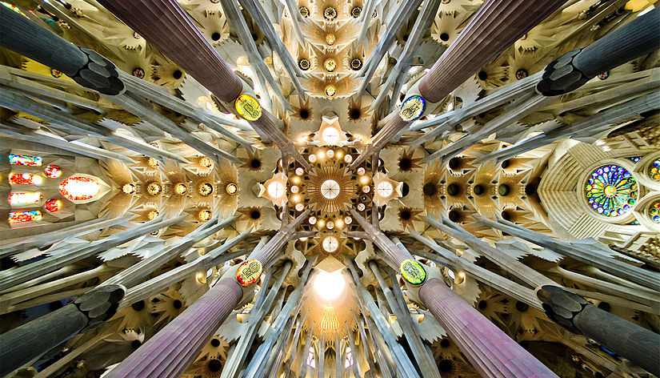
Sagrada Familia
Notes:
association with Sigma Xi. NOTES and RESOURCES for the SCIENCE CAFE. "Scientific, cultural, and spiritual connections between McHarg's landmark work in architecture will be linked with the work of other visionaries: The talk will be richly illustrated from (1) Ernst Haeckel's "Art Forms of Nature" (1899-1904) and its encouragement of an aesthetic, holistic vision of art and science based on his seminal research on oceanic microorganisms, and (2) the architecture of Antoni Gaudí, whose world-heritage architecture was deeply informed by and continually expresses his love and study of nature (spiritually manifest in his huge Sagrada Familia (basilica) in Barcelona (1883-contiunuing today).“
This gives a biological background to Kant’s famous aphorism:
"The senses cannot think. The understanding cannot see."
And Pascal’s
“The heart has reasons of which reason knows not”
( Kant in CPR cited by Wechsler 1978:2) (or: "Perception without conception is blind, while conception without perception is empty." (Kant CPR 1978) [recalls “Science without religion is lame, religion without science is blind.” (Albert Einstein in Science, Philosophy and Religion: a Symposium (1941) ch. 13)

Slide 44
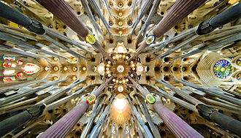
Sagrada Familia
Notes:
April 14, 2015 Science Café : "Biomorphic Art and Architecture -- Design with Nature" Presented by STKF Science Café at Ijams Nature Center visitor center building meeting room, 5:30-7:00 PM. Science Café is a project of WGBH Science Unit in association with Sigma Xi. NOTES and RESOURCES for the SCIENCE CAFE. "Scientific, cultural, and spiritual connections between McHarg's landmark work in architecture will be linked with the work of other visionaries: The talk will be richly illustrated from (1) Ernst Haeckel's "Art Forms of Nature" (1899-1904) and its encouragement of an aesthetic, holistic vision of art and science based on his seminal research on oceanic microorganisms, and (2) the architecture of Antoni Gaudí, whose world-heritage architecture was deeply informed by and continually expresses his love and study of nature (spiritually manifest in his huge Sagrada Familia (basilica) in Barcelona (1883-contiunuing today).“
This gives a biological background to Kant’s famous aphorism:
"The senses cannot think. The understanding cannot see."
And Pascal’s
“The heart has reasons of which reason knows not”
( Kant in CPR cited by Wechsler 1978:2) (or: "Perception without conception is blind, while conception without perception is empty." (Kant CPR 1978) [recalls “Science without religion is lame, religion without science is blind.” (Albert Einstein in Science, Philosophy and Religion: a Symposium (1941) ch. 13)

Slide 45
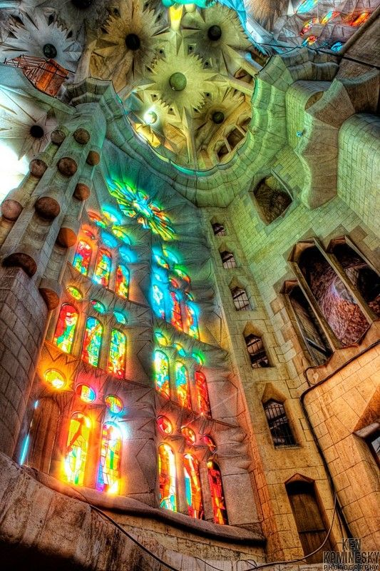
Virtual Visit
Notes:
http://www.sagradafamilia.cat/sf-eng/docs_instit/vvirtual.php?vv=1

Slide 46
Notes:
The nave in the Sagrada Familia with a hyperboloid vault. Inspiration from nature is taken from a tree, as the pillar and branches symbolise trees rising up to the roof. (Wikipedia)

Slide 47
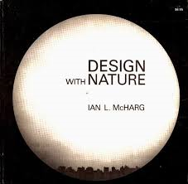
1969
Notes:
Ian L. McHarg (20 November 1920 – 5 March 2001) was a Scottish landscape architect and a renowned writer on regional planning using natural systems. He was the founder of the department of landscape architecture at the University of Pennsylvania in the United States. His 1969 book Design with Nature pioneered the concept of ecological planning. It continues to be one of the most widely celebrated books on landscape architecture and land-use planning. In this book, he set forth the basic concepts that were to develop later in Geographic information systems. –Wikipedia
In 1969, he published Design with Nature, which was essentially a book of step-by-step instructions on how to break down a region into its appropriate uses (Wenz, 2). McHarg also was interested in garden design and believed that homes should be planned and designed with good private garden space. He promoted an ecological view, in which the designer becomes very familiar with the area through analysis of soil, climate, hydrology, etc. Design With Nature was the first work of its kind "to define the problems of modern development and present a methodology or process prescribing compatible solutions".^{[3]} The book also had an impact on a variety of fields and ideas. Frederick R. Steiner tells us that "environmental impact assessment, new community development, coastal zone management, brownfields restoration, zoo design, river corridor planning, and ideas about sustainability and regenerative design all display the influence of Design with Nature".^{[1]}

Slide 48
environmental impact assessment,
new community development,
coastal zone management,
brownfields restoration,
zoo design,
river corridor planning, and
ideas about sustainability and regenerative design
Notes:
In 1971 McHarg delivered a speech at the North American Wildlife and Natural Resources Conference in Portland, Oregon, called
"Man: Planetary Disease". In the speech he asserted that, due to the views of man and nature that have infiltrated all of western culture, we are not guaranteed survival. Of man, McHarg said, "He treats the world as a storehouse existing for his delectation; he plunders, rapes, poisons, and kills this living system, the biosphere, in ignorance of its workings and its fundamental value." ^{[4]} To this end man is a "planetary disease", who has lived with no regard for nature. He discusses how in the Judeo-Christian traditions, the Bible says that man is to have dominion over the earth. McHarg says that for man to survive, this idea must be taken as an allegory only, and not as literally true. Lest this statement be construed as anti-religion, he cites Paul Tillich (Protestantism), Gustav Weigel (Catholicism), and Abram Heschel (Judaism) as noted religious scholars who are also in agreement with him on this point.

Slide 50
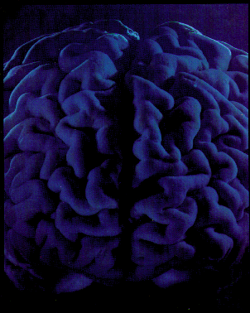
TRUTH in the BRAIN
LEFT HEMISPHERE
Coherence: creates a “stable and internally consistent belief system”
(Ramachandran 1998)
Probabilistic reasoning
(Osherson et al 1998)
Abstract object recognition
(Marsolek 1999)
RIGHT HEMISPHERE
Correspondence: tests reality and if damaged, confabulation runs rampant
(Ramachandran 1998)
Deductive reasoning
(Osherson et al 1998)
Specific object recognition
(Marsolek 1999)
Kant: "The senses cannot think, the understanding cannot see.”
Notes:
LEFT HEMISPHERE
Coherence: creates a “stable and internally consistent belief system – works hard to “save appearances” (Ramachandran 1998)
Probabilistic reasoning (Osherson et al 1998)
Abstract object recognition (Marsolek 1999)
RIGHT HEMISPHERE
Correspondence: tests reality and if damaged, confabulation runs rampant (Ramachandran 1998)
Deductive reasoning (Osherson et al 1998)
Specific object recognition (Marsolek 1999)
LEFT Probabilistic reasoning incr activity in dorsolateral frontal area
RIGHT Deductive reasoning prevalence of occipital and parietal activity
Osherson et al 1998 Distinct brain loci in deductive versus probabilistic reasoning (Neuropsychologia 36(4):369-376)
============================
Marsolek, Chad J 1999 Dissociable neural subsytems underlie abstract and specific object recognition. Psychologiucal Science 10(2):111-117.
============================
The asymmetry of brain function is well enough known, especially with respect to language: not only are the sounds of speech specified in the left hemisphere, by syntactical structure of speech and semantics- the orderliness of speech are apparently left hemisphere functions. (The right hemisphere, on the other hand, seems involved with the more subtle and expressive aspects of speech; also affect). The neurologist V.S. Ramachandran is fascinated by the panoply of denial that can be mustered by many brain damaged patients. In his view, the left hemisphere (like Gazzaniga’s “interpreter”) sifts through the superabundance of detail presented to it so as to order “it into a stable and internally consistent ‘belief system’ -- a story that make sense of of the available evidence” (1998:.134) – and how is new information handled? It is either ignored or squeezed “into your preexisting framework, to preserve stability.” This, Ramachandran proposes, is the essential rational behind all the so-called |Freudian defenses – the denials, repressions, confabulations and other forms of self delusion that govern our daily lives. Far from being maladaptive, such every day defense mechanisms prevent the brain from being hounded into directionless indecision by the ‘combinatorial explosion’ of possible stories that might be written from the material available to the senses. The penalty of course, is that you are ‘lying’ to yourself, but it’s a small price to pay for the coherence and stability on the system as a whole” (p 134-135) (and see Daniel Goleman’s Vital Lies, Simple Truths (1985) and “the willing suspension of disbelief.”).
Ramachandran points out that after strokes of the “emotional” right hemisphere, “patients tend to be blissfully unconcerned about their predicament, even mildly euphonic, because without the emotional right hemisphere” they simply don’t comprehend the magnitude of their loss” (1998:134)
Ramachandra, VS and Sandra Blakeslee. 1998. Phantoms in the Brain. Morrow, New York. 328 pp.
Gazzaniga’s “interpreter” is a left-hemisphere capacity “to make an inference about both internal bodily states and external actions of ourselves and others . . . a powerful system that is at the core of human belief formation . . . . a capacity that saves us from being completely beholden to the environment -- and thus in someways has outsmarted itself.” (p. 113). (Howard Bloom called my attention to Gazzaniga)
The right hemisphere, on the other hand is Ramachandran’s revolutionary – rather than saving appearances and maintaining the status quo –if even by lying to one’s self, the right hemisphere is “Kuhnian” in its force of a paradigm shift when anomalies can no longer be credibly accommodated – when it is damaged, the left hemisphere’s confabulations can run rampant.

Slide 51
Types of Consciousness
AFFECTIVE
More Subcortical
Less Computational
More Analog
Intentions in Action
Action to Perception
Neuromodulator codes (Neuropeptide)
COGNITIVE
More Neocortical
More Computational
More Digital
Intentions to Act
Perception to Action
Neurotransmitter Codes (Glutamate, etc)
Notes:
From Jaak Panksepp
AFFECTIVE
More Subcortical
Less Computational
More Analog
Intentions in Action
Action to Perception
Neuromodulator codes (Neuropeptide)
COGNITIVE
More Neocortical
More Computational
More Digital
Intentions to Act
Perception to Action
Neurotransmitter Codes (Glutamate, etc)

Slide 52
Types of Thinking
DIONYSIAN
external locus of control
affective-cognitive belief systems, high susceptibility to hypnotic suggestions
high levels of written output of low complexity and suspended critical appraisal
APOLLONIAN
internal locus of control
cognitive-affective belief systems, low susceptibility to hypnotic suggestions
low levels of written output of high complexity, and immediate critical appraisal.
Notes:
from: Krus, D.J., et al. (1982) Some characteristics of Apollonian and Dionysian dimensions of economic theories. Psychological Reports, 50, 967-974. (http://www.visualstatistics.net/Publications/Free%20to%20Choose/Economic_Theories.htm )
The dimension loading on Zen, Goethe, and East scales was labeled Dionysian. High correlations of this dimension were found with an external locus of control, high trust proneness, high absorption levels, focal-peripheral space awareness, affective-cognitive belief systems, high susceptibility to hypnotic suggestions, high levels of written output of low complexity and suspended critical appraisal. The dimension loading on Consciousness I, Consciousness II, and West scales was termed Apollonian. This dimension correlated highly with internal locus of control, low trust proneness, peripheral-focal space awareness, cognitive-affective belief systems, low sus ­ceptibility to hypnotic suggestions, low levels of written output of high complexity, and immediate critical appraisal.” “

Slide 53
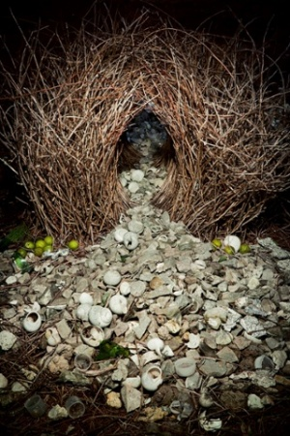
NATURAL ARCHITECTS
Biomorphic Art and Architecture -- Design with Nature
Gray Bowerbird nest
Notes:
Grey bowerbird bower in Northern Territory, Australia. The grey bowerbird goes to extreme lengths to build a love nest from interwoven sticks and then covers the floor with decorative objects. The more artful the arbor, the greater the chance a male has of attracting a mate. Photograph: Ingo Arndt
The Guardian: The world's best animal architecture - in pictures
Tree ants forming chain gangs, love nests built by bowerbirds and a whole graveyard of termite mounds ... here are the most amazing homes animals can build
• Animal Architecture by Ingo Arndt is published by Abrams on 1 May

Slide 54
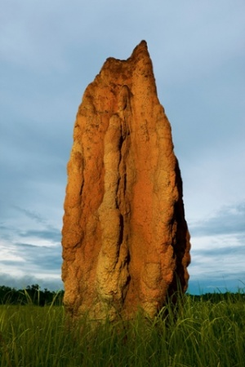
NATURAL ARCHITECTS
Biomorphic Art and Architecture -- Design with Nature
Cathedral termit mound in Australia – 6 meters high!
Notes:
A cathedral termite mound in Northern Territory, Australia. These towers often reach more than 6m high, and are some of the most spectacular animal constructions in the world. A single structure can accommodate 2-3million termites. Small balls (a mix of earth and saliva) are brought by the workers to build up the mound. Soldier ants with gigantic heads and well-fortified pincers watch over the workers. Photograph: Ingo Arndt

Slide 55
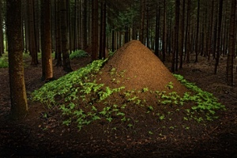
NATURAL ARCHITECTS
Biomorphic Art and Architecture -- Design with Nature
European red ant nest – 2 meters high
Notes:
European red wood ant nests in Hessen, Germany. In comparison to their body size of just one centimetre, red wood ants build skyscrapers. Their anthills can reach more than 2m high and 5m wide. Inside the tower, there is a mega system of paths so that no water can penetrate. They often transport building materials that weigh 40 times their body weight. Photograph: Ingo Arndt

Slide 56
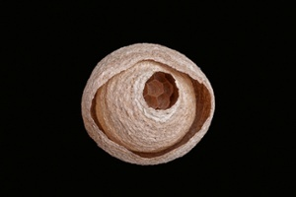
NATURAL ARCHITECTS
Wasp nest – inspired paper in China
Notes:
A wasp nest made of masticated wood. Wasps often use a type of paper created from wooden particles and their secretions. Thousands of years ago, Chinese paper inventors carefully observed wasps and drew inspiration. Typically, large wasps’ nests consist of several horizontal combs, aligned in parallel lines. Several layers of the wasp paper close off the entire ensemble from the outside, and there is only one small entrance. The layers offer physical protection, and the air between the combs protects against strong temperature fluctuations.

Slide 57
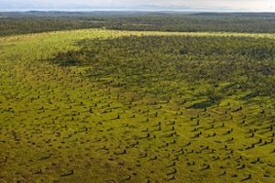
NATURAL ARCHITECTS
Compass termite towers – 3 meters tall but maintain constant temperature inside
Notes:
There are huge fields littered with compass termite towers, which average 3m tall, throughout northern Australia. The flat-sided constructions have a north-south orientation, and an ingenious ventilation system, so they keep a constant temperature inside. Morning and evening light hits the flat sides and warms them up, then at midday, the sun only hits the narrow, upper edges so the temperature doesn't rise.

Slide 58
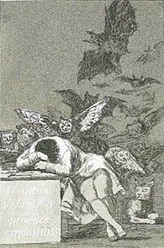
BUT we are justifiably wary of emotions and emotionality:
"The sleep of reason produces monsters"
Goya 1799
Notes:
“The series of etchings known as the Caprichos, begun during Goya's convalescence and published in 1799, hint at his future art; yet they still express the spirit of the Enlightenment. The famous plate once intended as the title page, which Goya moved to the middle of the series, shows a Goya-like intellectual asleep at his desk, surrounded by cats and bats and a clear-eyed lynx. The caption, "El sueño de la razón produce monstruos"), is ambiguous: sueño can mean "sleep" or "dream," and it is unclear whether Goya means that the absence of reason breeds monsters or that reason is itself a kind of sleep.” From NYRB. 50(19):6-11. “The Art of Disaster,” Review of Goya by Robert Hughes by Christopher Benfey December 4, 2003
The place of REASON has been elevated out of context because it is our most distinctive HUMAN characteristic. It is coordinated by the highest cerebral attainments and has a central role in restraining or selecting between instinctive or automatized patterns organized at "lower" levels of the brain. But it is impotent and helpless without a reliable sense of reality attained only by experience: "The senses cannot think. The understanding cannot see" (Kant); "The heart has reasons of which reason knows not” (Pascal)
The balance of coherence and correspondence: “It is the theory that decides what can be observed” (Albert Einstein); “The eye sees only what the mind is prepared to comprehend” (Robertson Davies); or “People only see what they are prepared to see” (Ralph Waldo Emerson).
Reason is, and ought only to be the slave of the passions, and can never pretend to any other office than to serve and obey them. (David Hume, A Treatise upon Human Nature (1739) bk. 2, pt. 3)
Reason is natural revelation, whereby the eternal Father of light, and fountain of all knowledge communicates to mankind that portion of truth which he has laid within the reach of their natural faculties. (John Locke, An Essay concerning Human Understanding (1690) bk. 4, ch. 19, sect. 4)
“Le coeur a ses raisons que la raison ne connaît point.” (“The heart has its reasons of which reason knows nothing.,” Blaise Pascal 1623–62, French mathematician, physicist, and moralist, in Pensées (1670, ed. L. Brunschvicg, 1909) sect. 4, no. 277).
"I hate reasonable people -- the activity of their brains sucks up all the blood out of their hearts. I was once afraid of turning out reasonable myself." (WB Yeats) (in "It Has Been Said" PSBM 1990, 33(3):375)
REASON. "induction has so far proved successful, therefore it is justified" is itself an inductive inference__ induction and empiricism, and thus circular. (Hume) The process of induction, or logical progression from particulars to a principle, was discussed in the first textbooks of logic ("Induction is a progression from singulars to universals" (Aristotle, Topics, 1.12.105a 13_14)), however, in many minds today the phrase "inductive logic" is virtually self_contradictory).
“Always to see the general in the particular is the very foundation of genius” according to Arthur Schopenhauer (HMS Beagle quote of the day, November 12, 1997)
REASON. “The more he is able to develop his consciousness as a subject over against objects, the more he can understand things in their relations to him and one another, the more he can manipulate these objects for his own interests, but also, at the same time, the more he tends to isolate himself in his own subjective prison, to become a detached observer cut off from everything else in a kind impenetrable alienated and transparent bubble which contains all reality in the form of purely subjective experience. (Thomas Merton, Zen and the Birds of Appetite, 1968:22)
There are two modes of knowing, through argument and experience. Argument brings conclusions and compels us to concede them, but does not cause certainty nor remove the doubts in order that the mind may remain at rest in truth, unless this is provided by experience (Roger Bacon, 1268)

Slide 59
The inner tension the delicate balance
AFFECTIVE & COGNITIVE or
PASSION & REASON or
DIONYSIAN & APOLLONIAN or
SENSUOUS & THOUGHTFUL
Is NOT something wholly under our control – these represent the balance of modules of mind and their neurochemical support systems
place of REASON has been elevated out of context because it is our most distinctive HUMAN characteristic and the one enjoys increase as we develop and new experiences are assimilated or accommodated
REASON is coordinated by the highest cerebral attainments and has a central role in restraining or selecting between instinctive or automatized patterns organized at "lower" levels of the brain.
But reason is impotent and helpless without the experience of reality: "The senses cannot think. The understanding cannot see" (Kant); "The heart has reasons of which reason knows not” (Pascal)

Slide 60
The inner tension the delicate balance
AFFECTIVE & COGNITIVE or
PASSION & REASON or
DIONYSIAN & APOLLONIAN or
SENSUOUS & THOUGHTFUL
INDIVIDUATION & SOCIALIZATION
THE SELF & THE WORLD
SPACE & PLACE
(adventure & safety)

Slide 61
Suppression of Instinct
". . . the domain of the instincts . . . was considered as eternally hostile and detrimental to reason . . . .
whatever belongs to the sphere of sensuousness, pleasure, impulse has the connotation of being antagonistic to reason--something that has to be subjugated, constrained."
(Marcuse, Eros and Instinct, 1955:145)
Notes:
Orpheus may be the poet’s hero – charming animals, even stones with his words. Words which appeal to the most recently evolved cognitive capacities of humanity, complementing, extending the more ancient non-verbal modes of communicating. Where surrealism and expressionism and the other reactions to positivism were disillusioned with language as a vehicle for insight and understanding, as an engine of transcendent harmony, the symbolists never lost faith. (Rene Wellek in DHI:IV 345b) [more on words]
[NOTE: In Marcuse, the performance principle is his version of the historical form of Freud’s reality principle., “the repressive transformation of the instincts” (1955:31) Marcuse, Herbert. 1955. Eros and Civilization: A Philosophical Inquiry into Freud. Random House.]

Slide 62
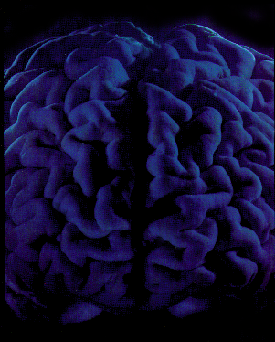
We see the world not as it is,
But as we are . . .
Notes:
The Natural History of Intuition: The New Neurobiology and Concepts of Self and Identity
ABSTRACT. Intuitive behavior is understood to be guided by nonconscious cognition. The natural history, or ethology, of any behavioral pattern involves the search for insight about its causes and consequences. “DEEP ethology” refers to the search for understanding based on the unique questions asked by each of four principal biological disciplines, each with their respective levels of organization, and how the answers obtained converge on a full understanding. The four disciplines are development, ecology, evolution, and physiology — DEEP. One’s understanding of one’s self is supremely intuitive and can be viewed from this perspective. Further, this understanding can empower individuals to more-or-less freely rely upon “intuition” to energize their daily lives as well as important decisions. This power is exemplified by creativity expressed in art and science, but also in clinical diagnosis. My presentation will touch briefly on each element of the DEEP ethological perspective on intuition and how they contribute to the fullest understanding of the phenomenon. Emphasis, however, will be placed on the proximate causation of behavior, the nervous system and its orchestration by physiological phenomena including endocrinology and neurophysiology. In doing this we will identify some of the boundaries of human possibilities as exemplified by their expression in extraordinary individuals.

Slide 63
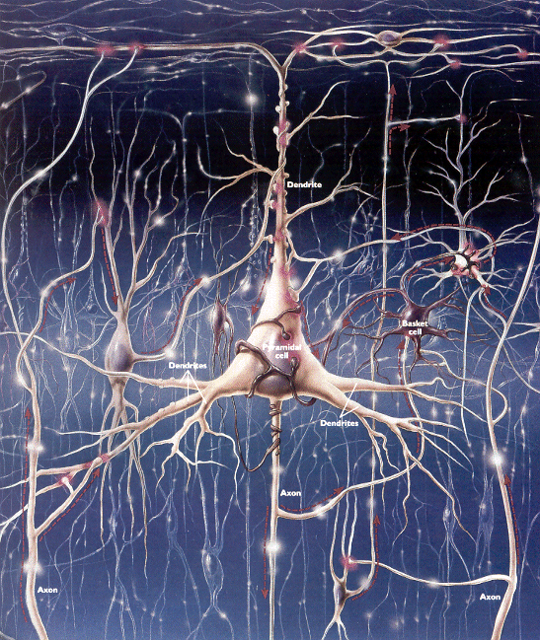
We see the world not as it is,
But as we are . . .
Notes:
“It is the theory that decides what can be observed” (Albert Einstein); “The eye sees only what the mind is prepared to comprehend” (Robertson Davies); or “People only see what they are prepared to see” (Ralph Waldo Emerson).
The Natural History of Intuition: The New Neurobiology and Concepts of Self and Identity
ABSTRACT. Intuitive behavior is understood to be guided by nonconscious cognition. The natural history, or ethology, of any behavioral pattern involves the search for insight about its causes and consequences. “DEEP ethology” refers to the search for understanding based on the unique questions asked by each of four principal biological disciplines, each with their respective levels of organization, and how the answers obtained converge on a full understanding. The four disciplines are development, ecology, evolution, and physiology — DEEP. One’s understanding of one’s self is supremely intuitive and can be viewed from this perspective. Further, this understanding can empower individuals to more-or-less freely rely upon “intuition” to energize their daily lives as well as important decisions. This power is exemplified by creativity expressed in art and science, but also in clinical diagnosis. My presentation will touch briefly on each element of the DEEP ethological perspective on intuition and how they contribute to the fullest understanding of the phenomenon. Emphasis, however, will be placed on the proximate causation of behavior, the nervous system and its orchestration by physiological phenomena including endocrinology and neurophysiology. In doing this we will identify some of the boundaries of human possibilities as exemplified by their expression in extraordinary individuals.

Slide 64
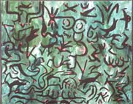
We see the world not as it is,
But as we are . . .
Notes:
Background: art by MEITHNER
“It is the theory that decides what can be observed” (Albert Einstein); “The eye sees only what the mind is prepared to comprehend” (Robertson Davies); or “People only see what they are prepared to see” (Ralph Waldo Emerson).
The Natural History of Intuition: The New Neurobiology and Concepts of Self and Identity
ABSTRACT. Intuitive behavior is understood to be guided by nonconscious cognition. The natural history, or ethology, of any behavioral pattern involves the search for insight about its causes and consequences. “DEEP ethology” refers to the search for understanding based on the unique questions asked by each of four principal biological disciplines, each with their respective levels of organization, and how the answers obtained converge on a full understanding. The four disciplines are development, ecology, evolution, and physiology — DEEP. One’s understanding of one’s self is supremely intuitive and can be viewed from this perspective. Further, this understanding can empower individuals to more-or-less freely rely upon “intuition” to energize their daily lives as well as important decisions. This power is exemplified by creativity expressed in art and science, but also in clinical diagnosis. My presentation will touch briefly on each element of the DEEP ethological perspective on intuition and how they contribute to the fullest understanding of the phenomenon. Emphasis, however, will be placed on the proximate causation of behavior, the nervous system and its orchestration by physiological phenomena including endocrinology and neurophysiology. In doing this we will identify some of the boundaries of human possibilities as exemplified by their expression in extraordinary individuals.

Slide 65
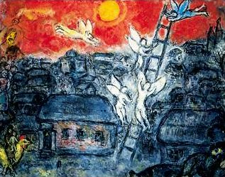
We see the world not as it is,
But as we are . . .
Notes:
“It is the theory that decides what can be observed” (Albert Einstein); “The eye sees only what the mind is prepared to comprehend” (Robertson Davies); or “People only see what they are prepared to see” (Ralph Waldo Emerson).
The Natural History of Intuition: The New Neurobiology and Concepts of Self and Identity
ABSTRACT. Intuitive behavior is understood to be guided by nonconscious cognition. The natural history, or ethology, of any behavioral pattern involves the search for insight about its causes and consequences. “DEEP ethology” refers to the search for understanding based on the unique questions asked by each of four principal biological disciplines, each with their respective levels of organization, and how the answers obtained converge on a full understanding. The four disciplines are development, ecology, evolution, and physiology — DEEP. One’s understanding of one’s self is supremely intuitive and can be viewed from this perspective. Further, this understanding can empower individuals to more-or-less freely rely upon “intuition” to energize their daily lives as well as important decisions. This power is exemplified by creativity expressed in art and science, but also in clinical diagnosis. My presentation will touch briefly on each element of the DEEP ethological perspective on intuition and how they contribute to the fullest understanding of the phenomenon. Emphasis, however, will be placed on the proximate causation of behavior, the nervous system and its orchestration by physiological phenomena including endocrinology and neurophysiology. In doing this we will identify some of the boundaries of human possibilities as exemplified by their expression in extraordinary individuals.

Slide 66
Design with Nature
Biomorphic Art and Architecture -- Design with Nature
We are creatures of contradiction, perpetually at crossroads:
our bodies are maelstroms of disintegration and renewal
Our species is wired to individuate and to socialize
We are “wired” to pursue security but we seek to maximize freedom.
Notes:
Natural science is one of man's weapons in his fight for freedom. For the purpose of attaining freedom in society, man must use social science to understand and change society and carry out social revolution. For the purpose of attaining freedom in the world of nature, man must use natural science to understand, conquer and change nature and thus attain freedom from nature.
Speech at the inaugural meeting of the Natural Science Research Society of the Border Region (February 5, 1940).

Slide 67
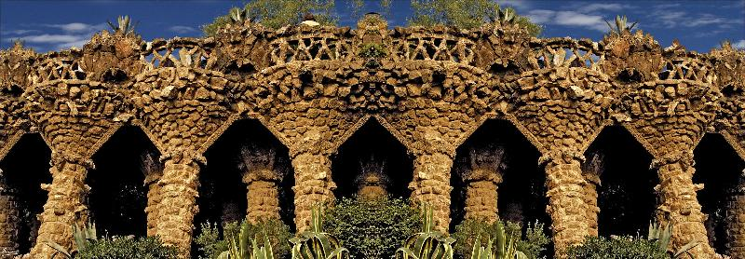

Slide 68
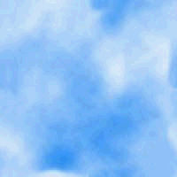
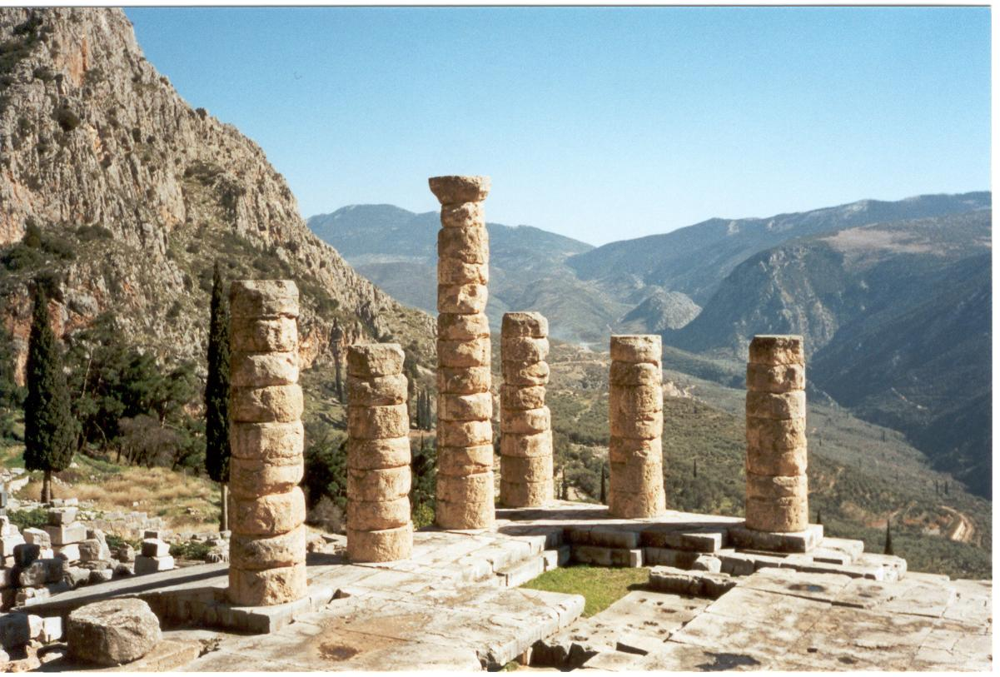
WHO THE HELL DO YOU THINK YOU ARE!?
To be an effective, competitive organism, we would be wise to follow the advice of the Oracle at Delphi: Γνωθηι σεαυτον “Gnothi se auton”
(Know thyself)
Is this the primal function of art? Of science?
the ancient ruins of the sanctuary of Apollo at Delphi. is spread out over the southern slopes of Mount Parnassos, beneath the Phaidriad rocks.
Notes:
KNOWING ONE’s SELF is arguably critical to maximizing one’s fitness !
Γνωθηι σεαυτον
One of the main religious sites in the Classical World was the sanctuary of Apollo at Delphi. Delphi is situated in Phocis and the ancient ruins spread out over the southern slopes of Mount Parnassos, beneath the Phaidriad rocks.
Apollo was worshipped at Delphi as the god of light, harmony and order. He was also the god possessed with the power of prophecy and through his oracles communicated the will of Zeus to mortals. Envoys went to the oracle to consult it over important matters of state, as well as some private matters. After making a sacrifice to the god, they paid a set sum and then awaited the message from the god. This was given through a priestess - the Pythia - whose incomprehensible mutterings were in turn interpreted by other priests.
Contests were held at Delphi every four years, similar to the Olympic Games, and contestants came to the sanctuary from throughout the Greek World. These games not only included sporting competitions but also music and poetry contests. The site had its own theatre and hippodrome for equestrian events. The games lasted a total of 8 days and the victor's trophy was a wreath of laurel, the tree sacred to Apollo and the right to erect a portrait statue within the sanctuary.
Worshippers would enter the sanctuary to Apollo from the south-east and then proceed along the Sacred Way towards the Temple of Apollo. This walkway was lined with votives which commemorated various victories such as the Athenian one for their victory at Marathon. These were then followed by a series of treasuries set up by different cities to house their religious emblems as well as riches etc. These temples were replicas of small temples and followed the basic principles of design. The most sacred building was the temple of Apollo, the remains of which date from the 4th Century B.C. The temple was in the Doric order, with 6 columns on the ends and 15 along the long sides. The centre of the temple is reached by a ramp. On the walls of the nave were two inscriptions of well known sayings 'know thyself' and 'nothing in excess'.
(http://www.ggsg.org.uk/subjects/humanities/classical_civilisation/classics/Greece/Delphi.html)

Slide 69
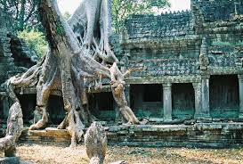
Biomorphic Art and Architecture : Design with Nature
Biomorphic Art and Architecture -- Design with Nature
Angor Watt
Notes:
Angor Wat

Slide 70
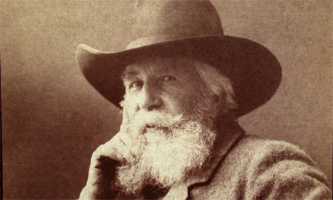
"On the one side spiritual freedom and truth, reason and culture, evolution and progress stand under the bright banner of science;
on the other side, under the black flag of hierarchy [infallable dogmatism], stand spiritual slavery and falsehood, irrationality and barbarism, superstition and retrogression"
EH Haeckel 1874
Notes:
This gives a biological background to Kant’s famous aphorism:
"The senses cannot think. The understanding cannot see."
And Pascal’s
“The heart has reasons of which reason knows not”
( Kant in CPR cited by Wechsler 1978:2) (or: "Perception without conception is blind, while conception without perception is empty." (Kant CPR 1978) [recalls “Science without religion is lame, religion without science is blind.” (Albert Einstein in Science, Philosophy and Religion: a Symposium (1941) ch. 13)

